Slide 1
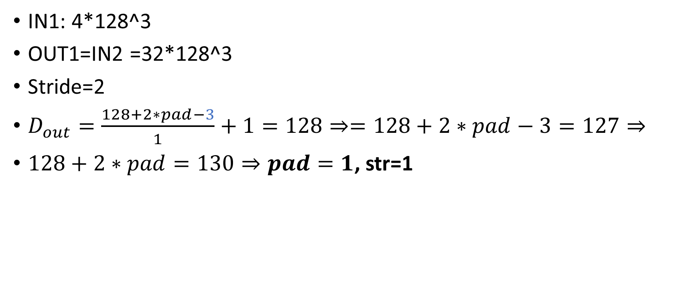
First layer
IN1: 4*128^3
OUT1=IN2 =32*128^3
Stride=2
$D_{out}=\frac{128+2∗pad−3}{1}+1=128⇒=128+2∗pad−3=127⇒$
$128+2∗pad=130⇒pad=1$, str=1

Slide 2

IN2: 32*128^3
OUT2=IN3 =64*64^3
$stride$1=2 $stride$2=1
$D_{out}$=$\frac{\frac{128+2∗pad1−3}{stride1}+1+2∗pad2−3}{stride2}+1=$ $\frac{\frac{128+2∗1−3}{2}+2∗1−2}{1}=$

Slide 3
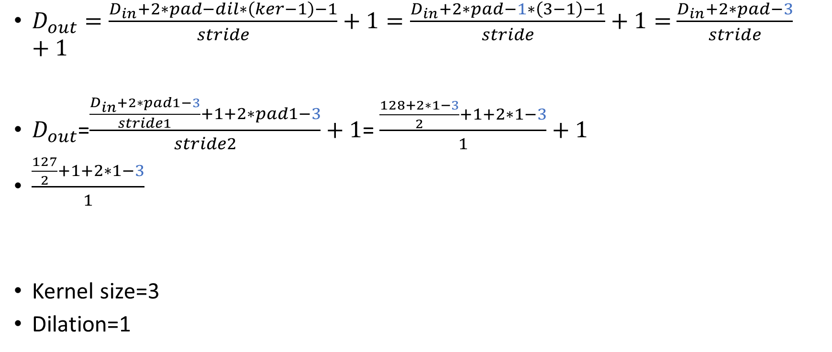
$D_{out}=\frac{D_{in}+2∗pad−dil∗\left(ker−1\right)−1}{stride}+1=\frac{D_{in}+2∗pad−1∗\left(3−1\right)−1}{stride}+1=$ $\frac{D_{in}+2∗pad−3}{stride}+1$
$D_{out}$=$\frac{\frac{D_{in}+2∗pad1−3}{stride1}+1+2∗pad1−3}{stride2}+1$= $\frac{\frac{128+2∗1−3}{2}+1+2∗1−3}{1}+1$
$\frac{\frac{127}{2}+1+2∗1−3}{1}$
Kernel size=3
Dilation=1

Slide 4
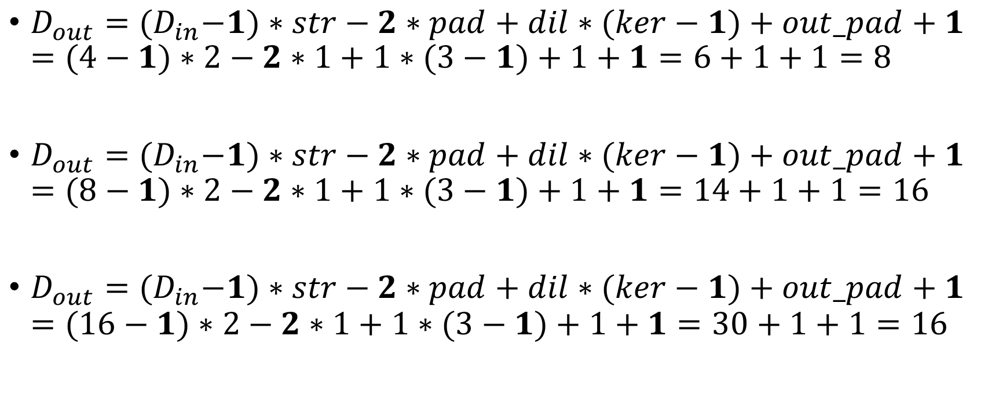
$D_{out}={(D}_{in}−1)∗str−2∗pad+dil∗(ker−1)+out_pad+1=(4−1)∗2−2∗1+1∗(3−1)+1+1=6+1+1=8$
$D_{out}={(D}_{in}−1)∗str−2∗pad+dil∗(ker−1)+out_pad+1=(8−1)∗2−2∗1+1∗(3−1)+1+1=14+1+1=16$
$D_{out}={(D}_{in}−1)∗str−2∗pad+dil∗(ker−1)+out_pad+1=(16−1)∗2−2∗1+1∗(3−1)+1+1=30+1+1=16$

Slide 5
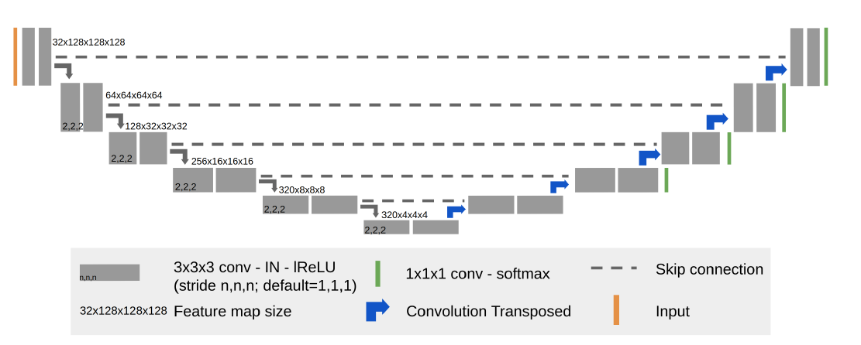
128
32
256
64
128+256
128
256+320=576
256
320+320
320
320
320

Slide 6
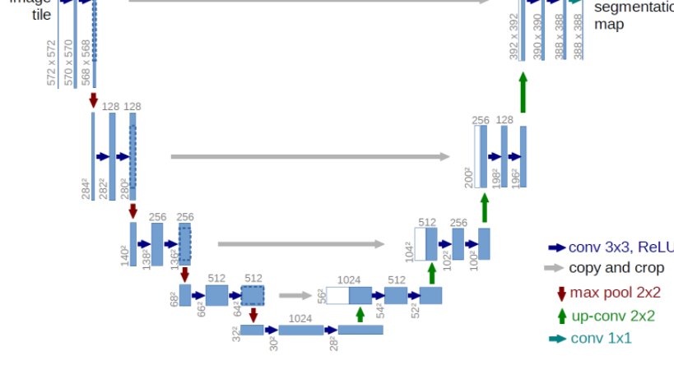

Slide 7
Up
X1 = CONVTRANSPOSE3D(x1),
Prev_Feat, X1
DoubleConv

Slide 8
Up
Dout​=(Din​−1)×stride[0]−2×padding[0]+dilation[0]×(kernel_size[0]−1)+output_padding[0]+1=(8-1)*2-2*1+1*(3-1)+1+1=14-2+2+2=16
Dout=2*Din

